Slide 1

CS-M151B
Computer Systems Architecture
Blaise Tine
UCLA Computer Science

Slide 2

Attendance

Slide 3
Homework #3 Questions?

Slide 4
RISC-V CPU Implementation

Slide 5
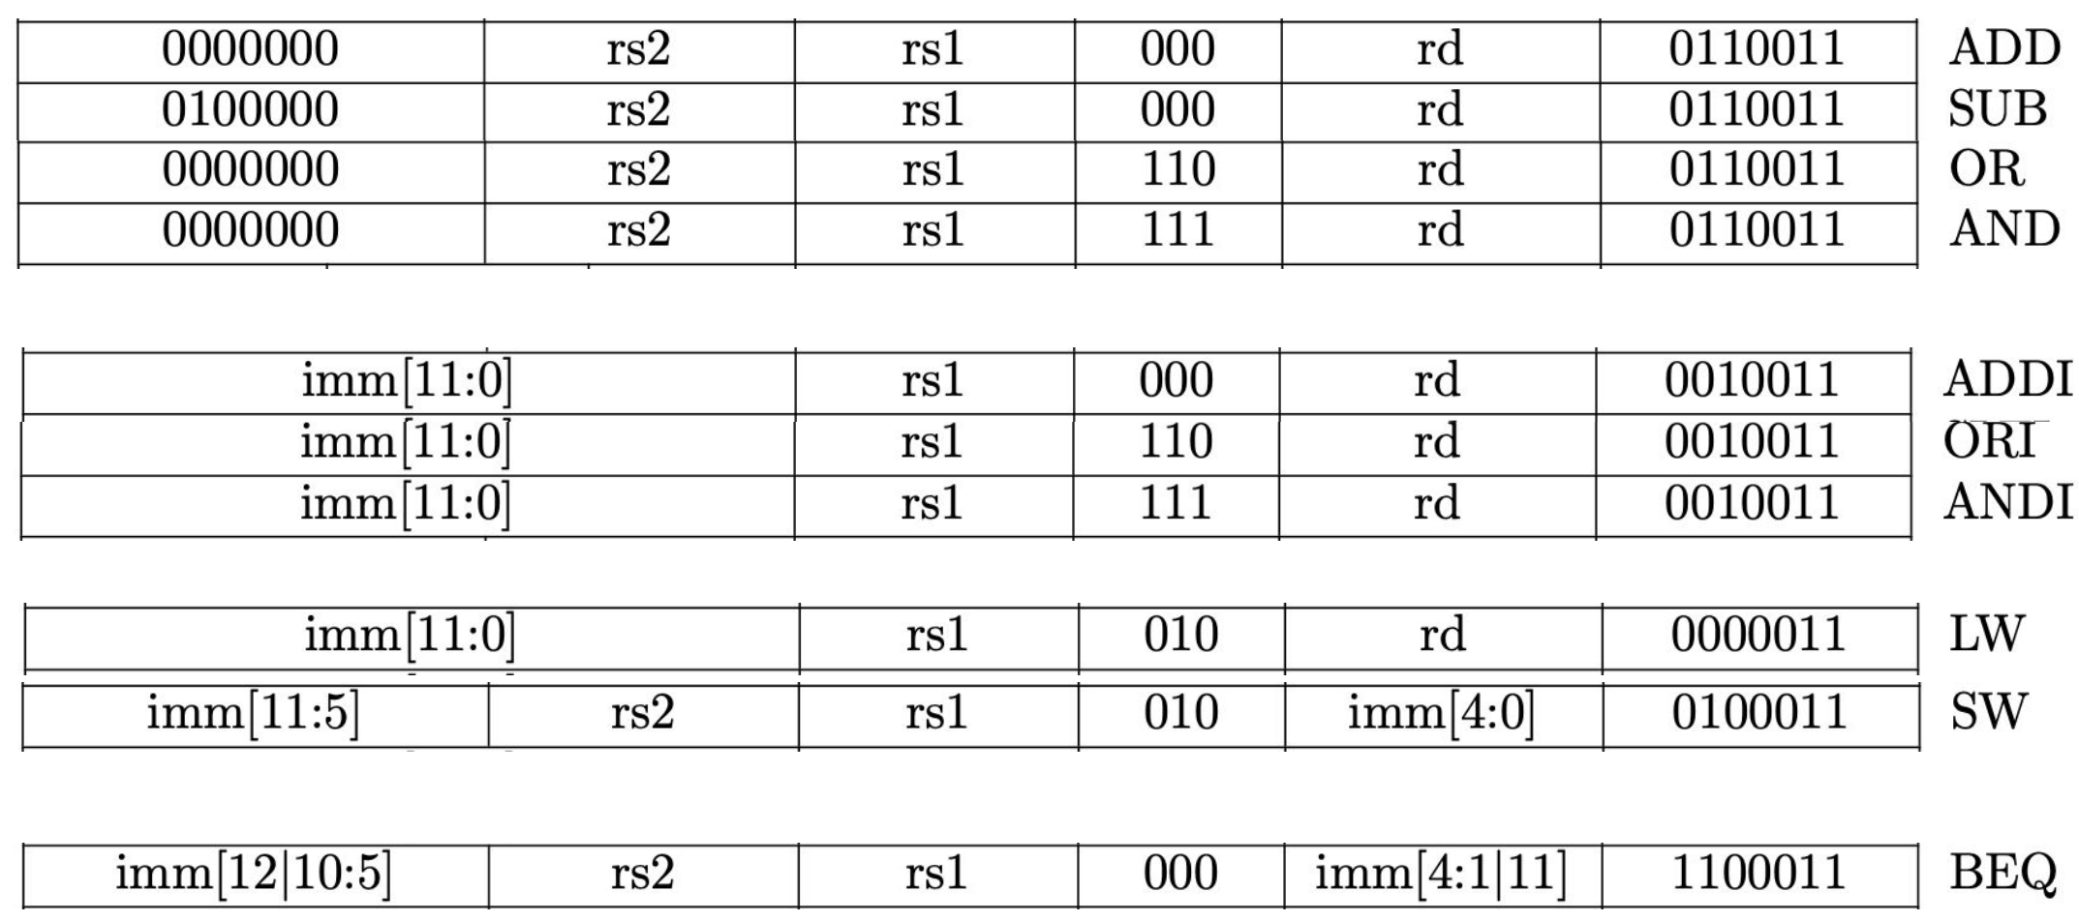
Basic RISC-V CPU Datapath
RISC-V ISA subset:
R-type
I-type
LD/ST
Branch

Slide 6
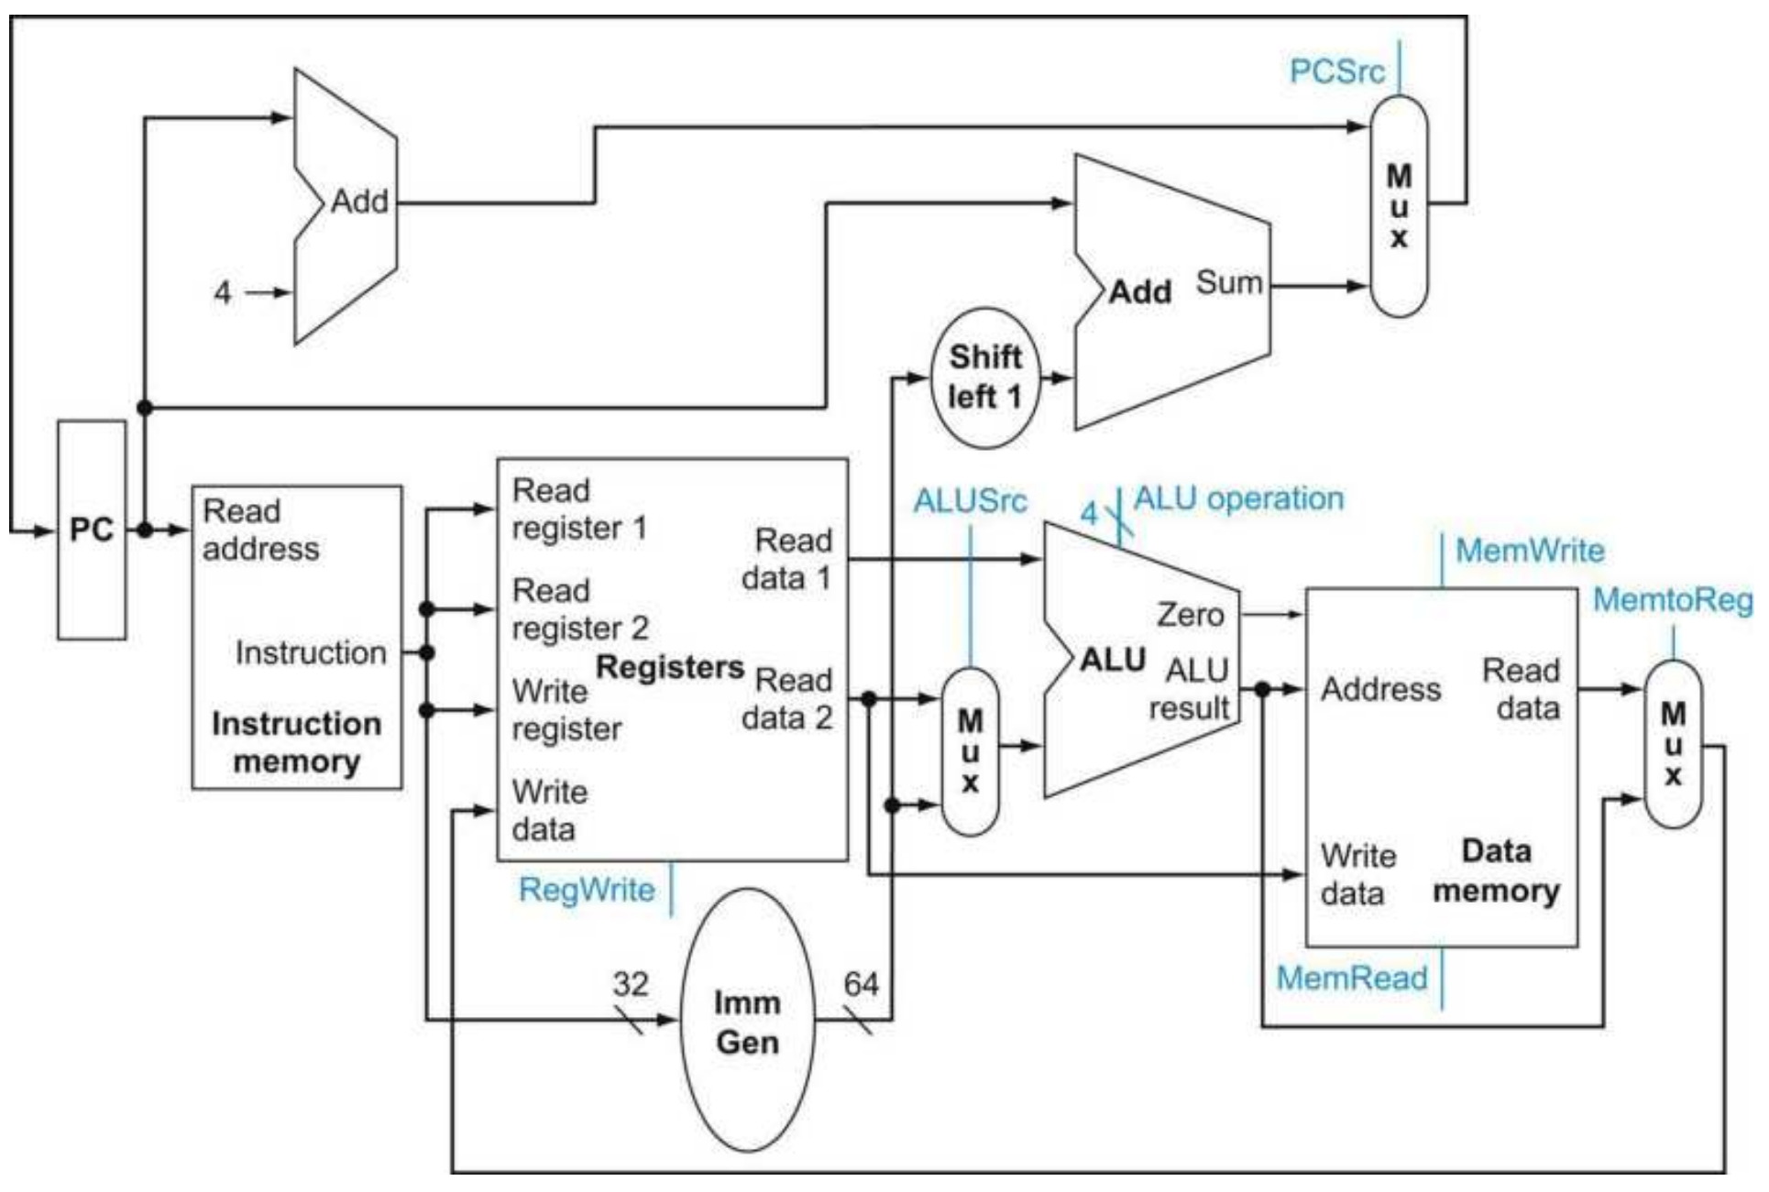
Basic RISC-V CPU Datapath
Basic Steps:
Fetch instruction from PC
Register file access
ALU execution
Memory access
Next PC update

Slide 7
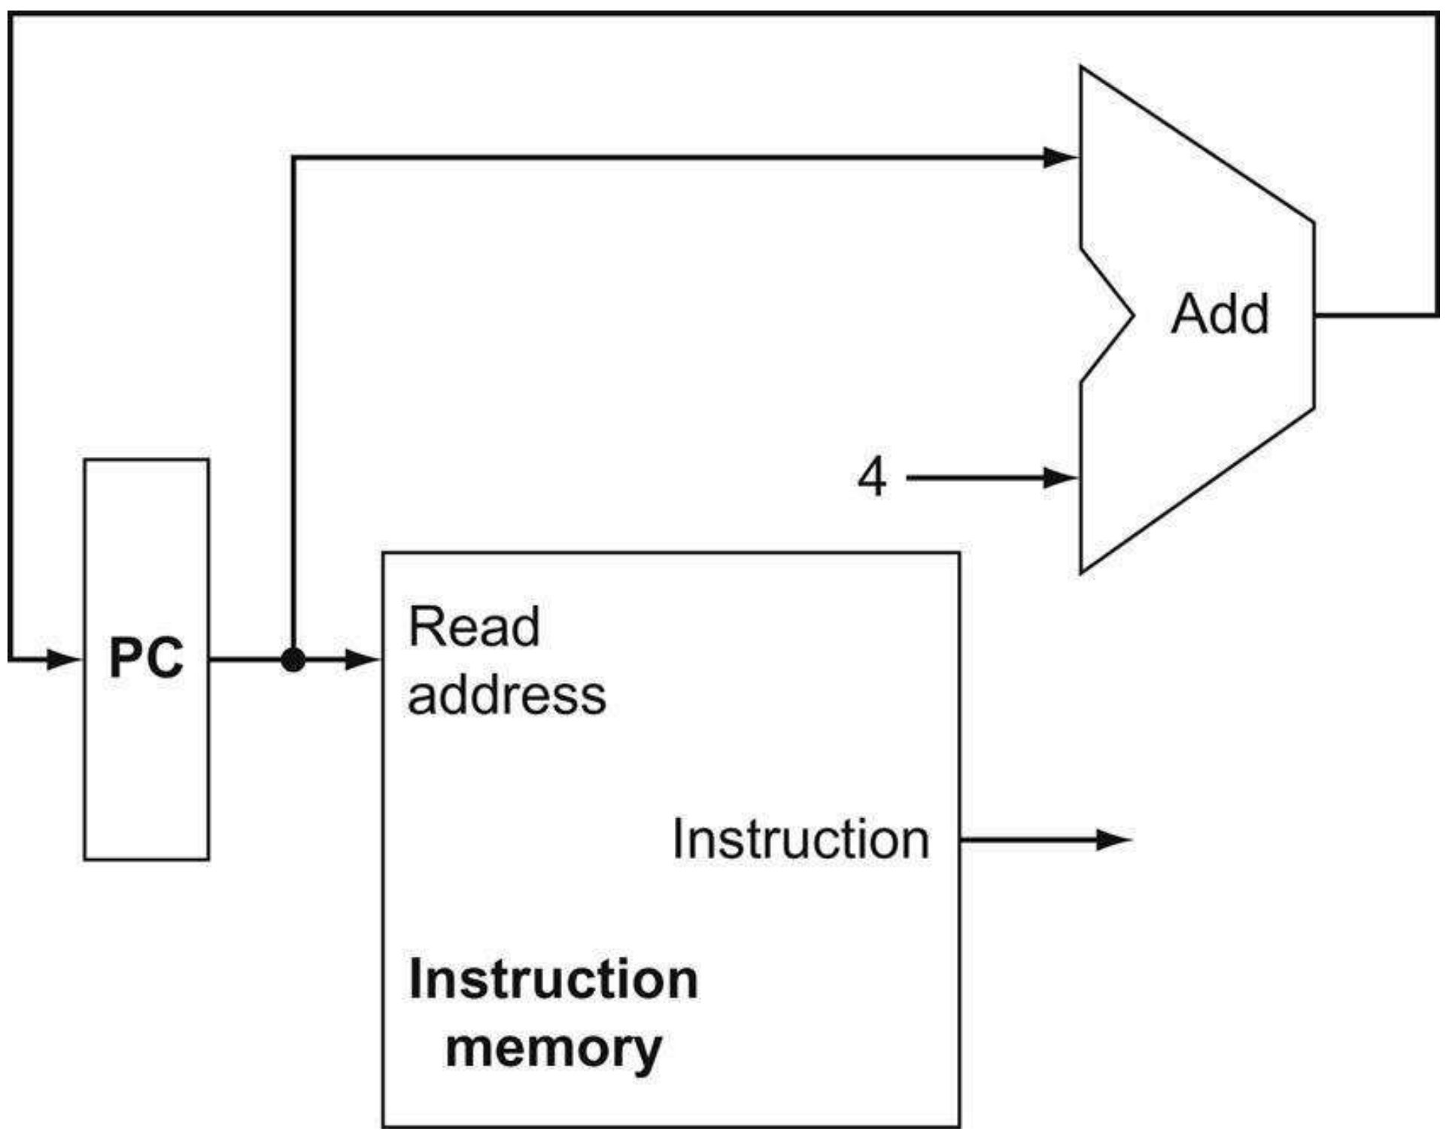
Basic RISC-V CPU Datapath
Next PC calculation:
Program counter stored in PC
Can perform the addition in parallel
While reading the next instruction

Slide 8
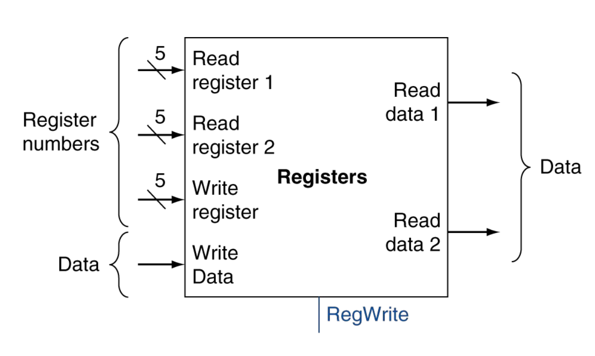
Basic RISC-V CPU Datapath
Register File:
32 total registers (5-bit addressing)
2x 5-bit source register addresses
1x 5-bit destination register address
RegWrite: write enable
How to decode register address?

Slide 9
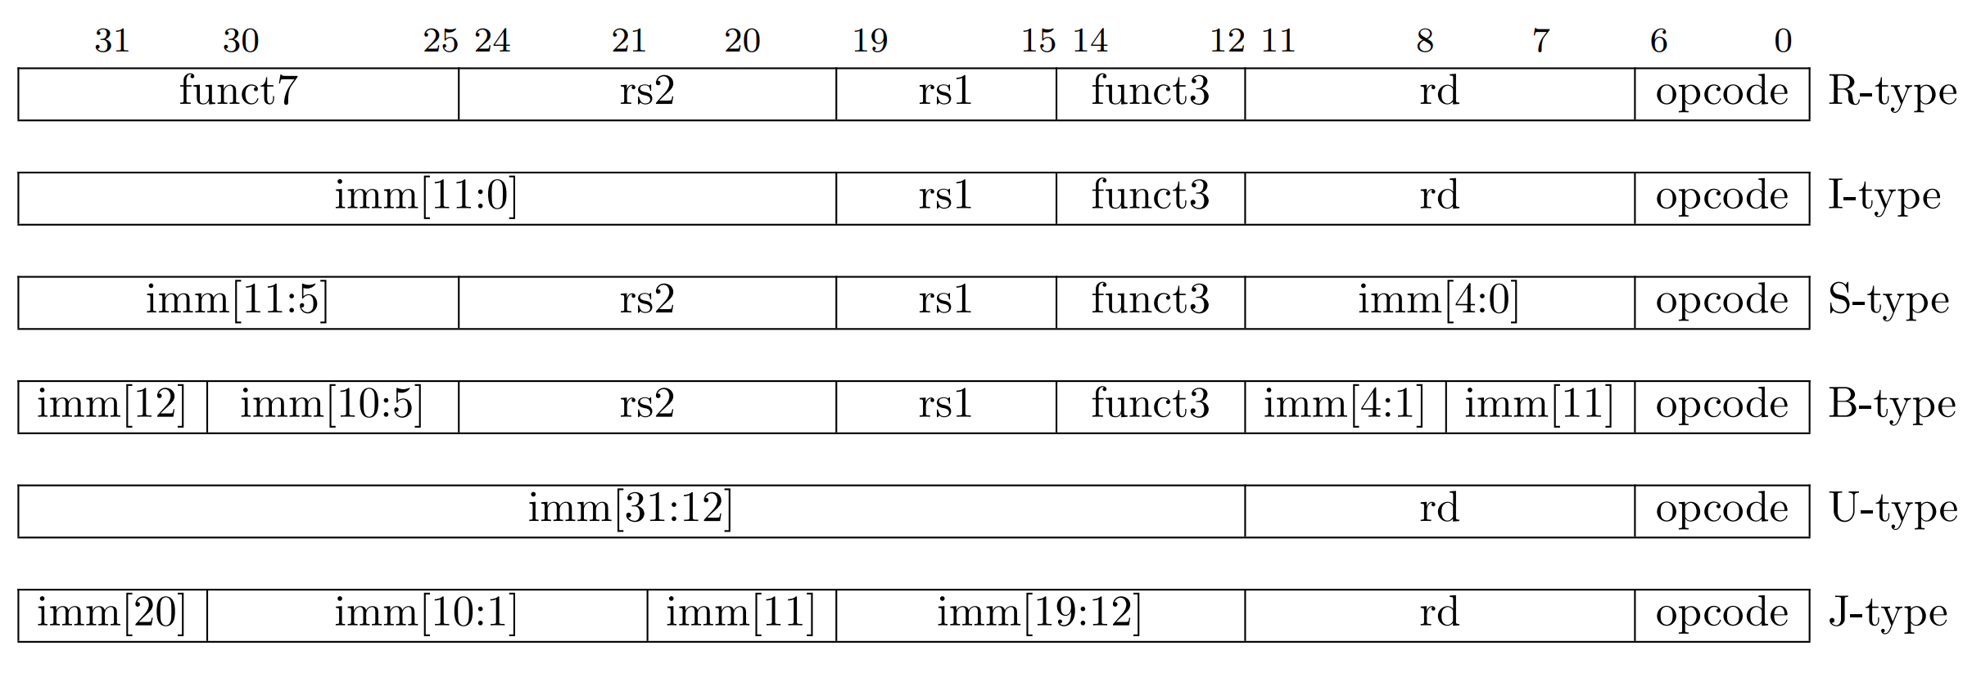
Basic RISC-V CPU Datapath
Register File:
How to decode register address?
No logic needed
why?

Slide 10
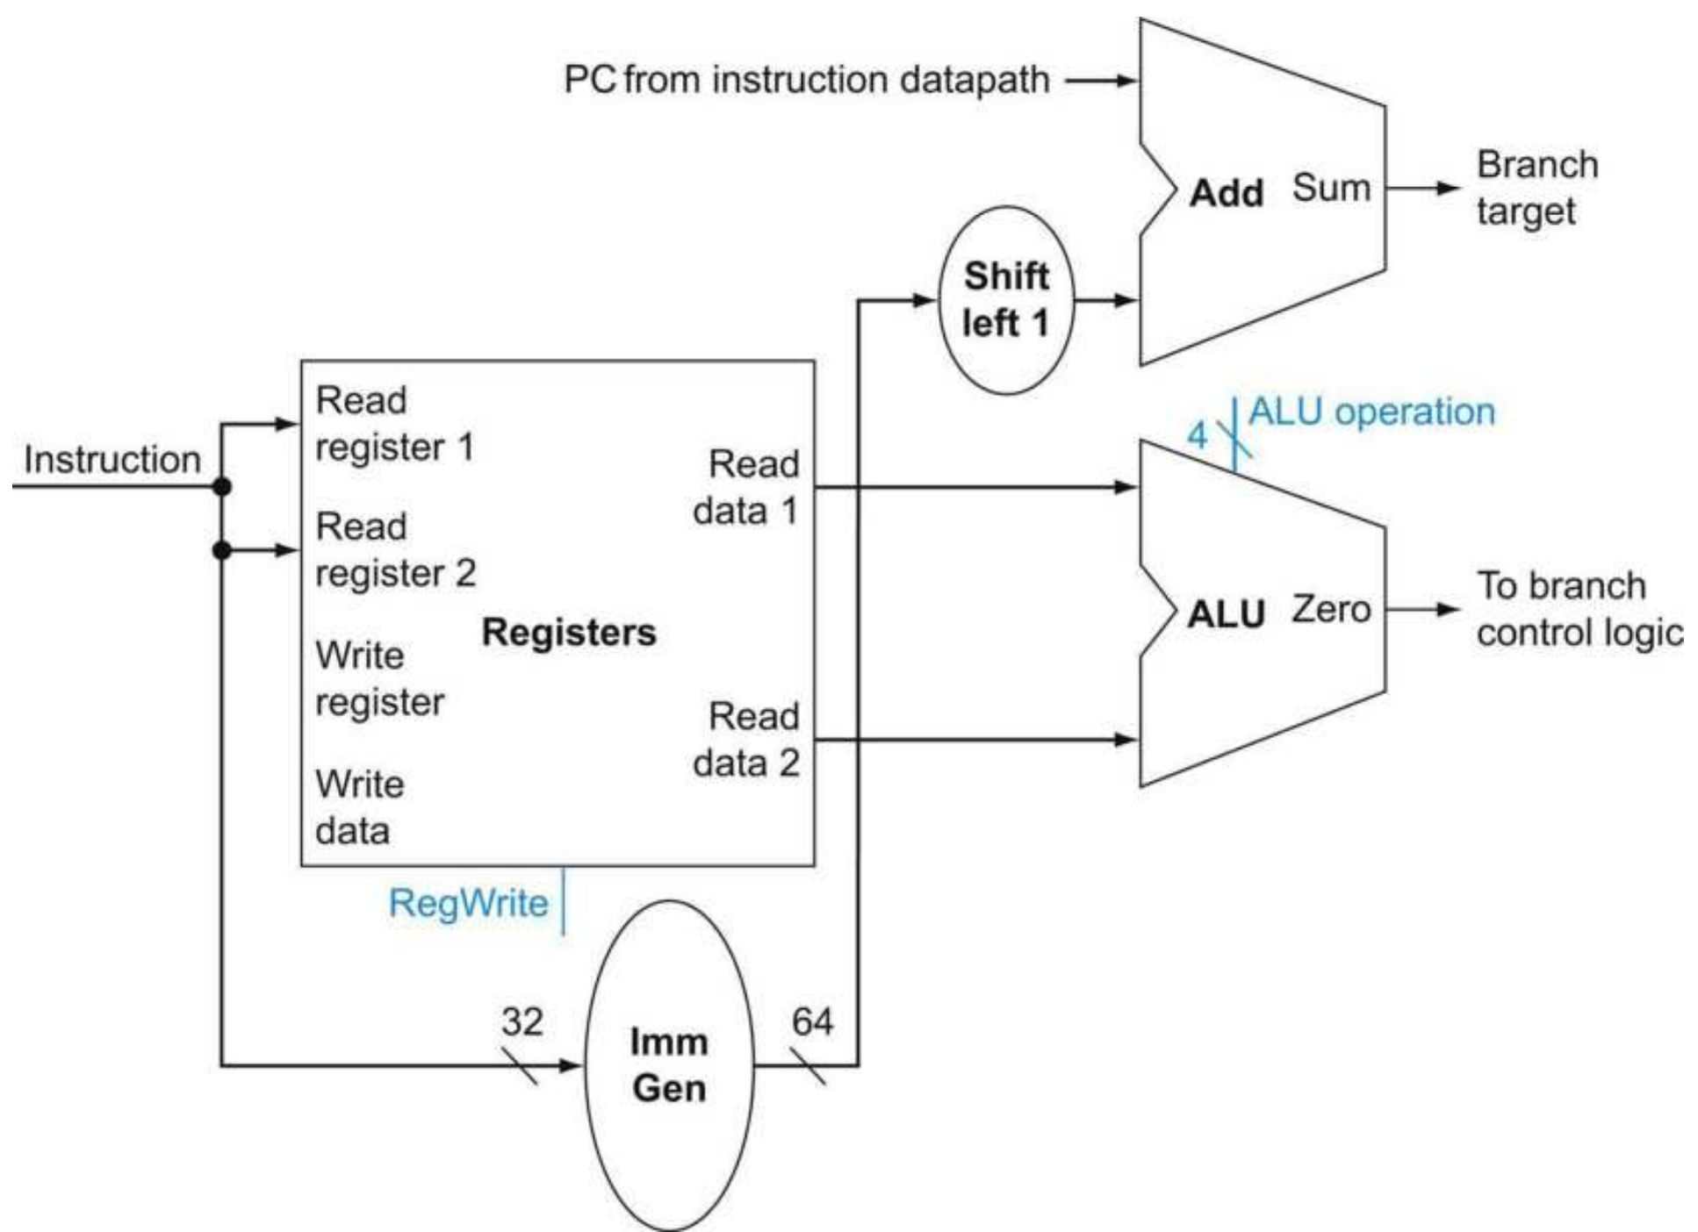
Basic RISC-V CPU Datapath
Branch operations:
Register access
Immediate generation
Branch target calculation
Branch condition evaluation
Parallelism?
2-3, 4
Critical path?
2-3

Slide 11
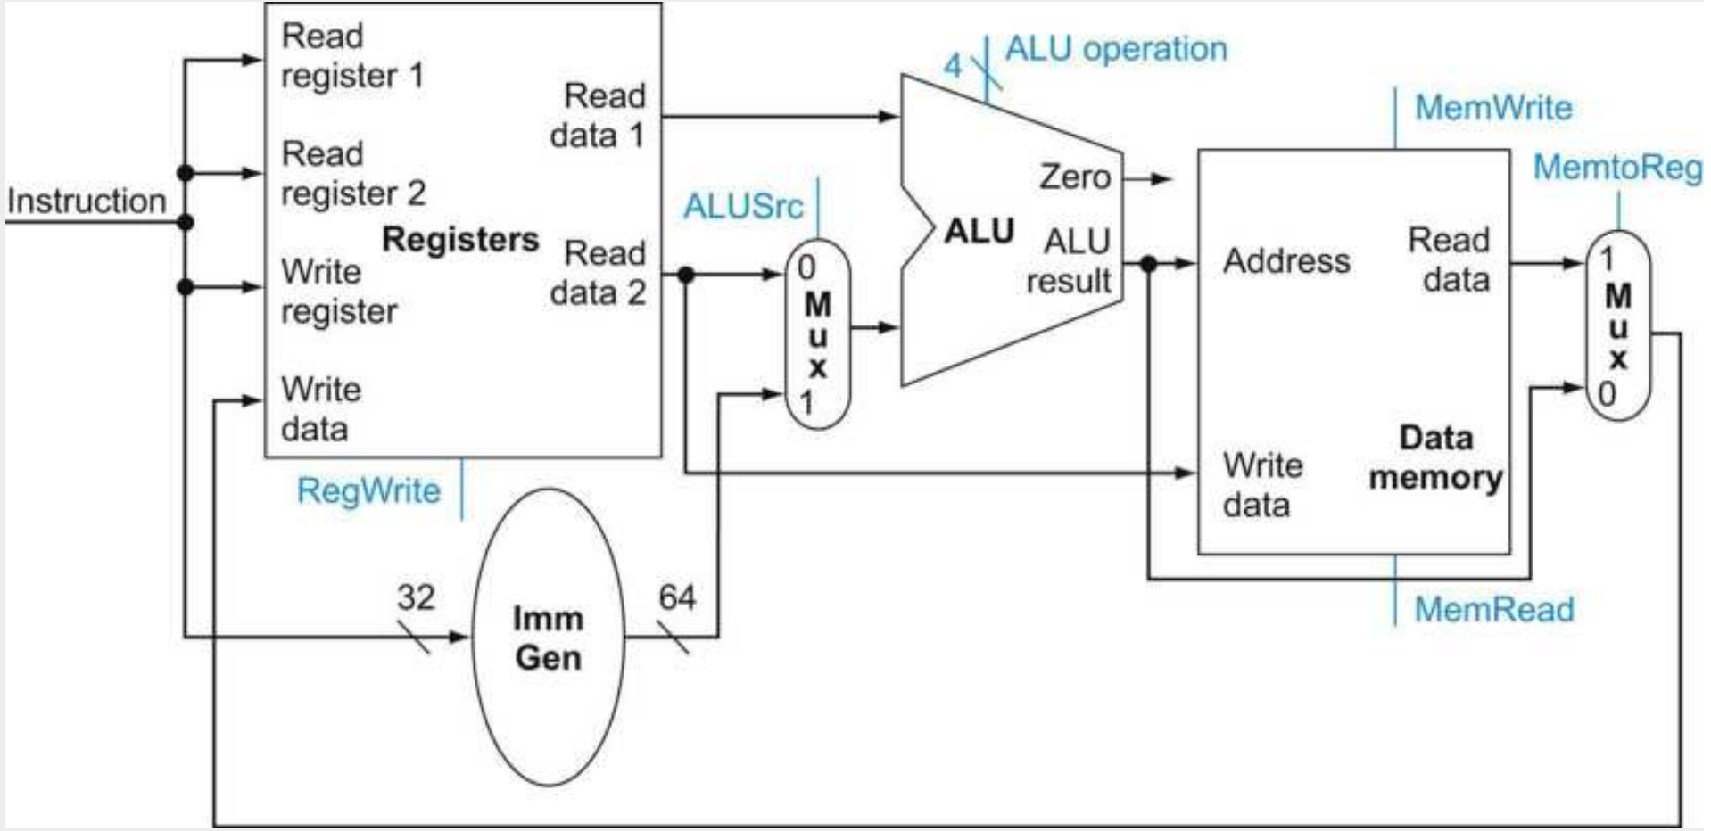
Basic RISC-V CPU Datapath
Memory Operations:
Address calculation
Memory access
ALUSrc select
0: register
1: immediate

Slide 12
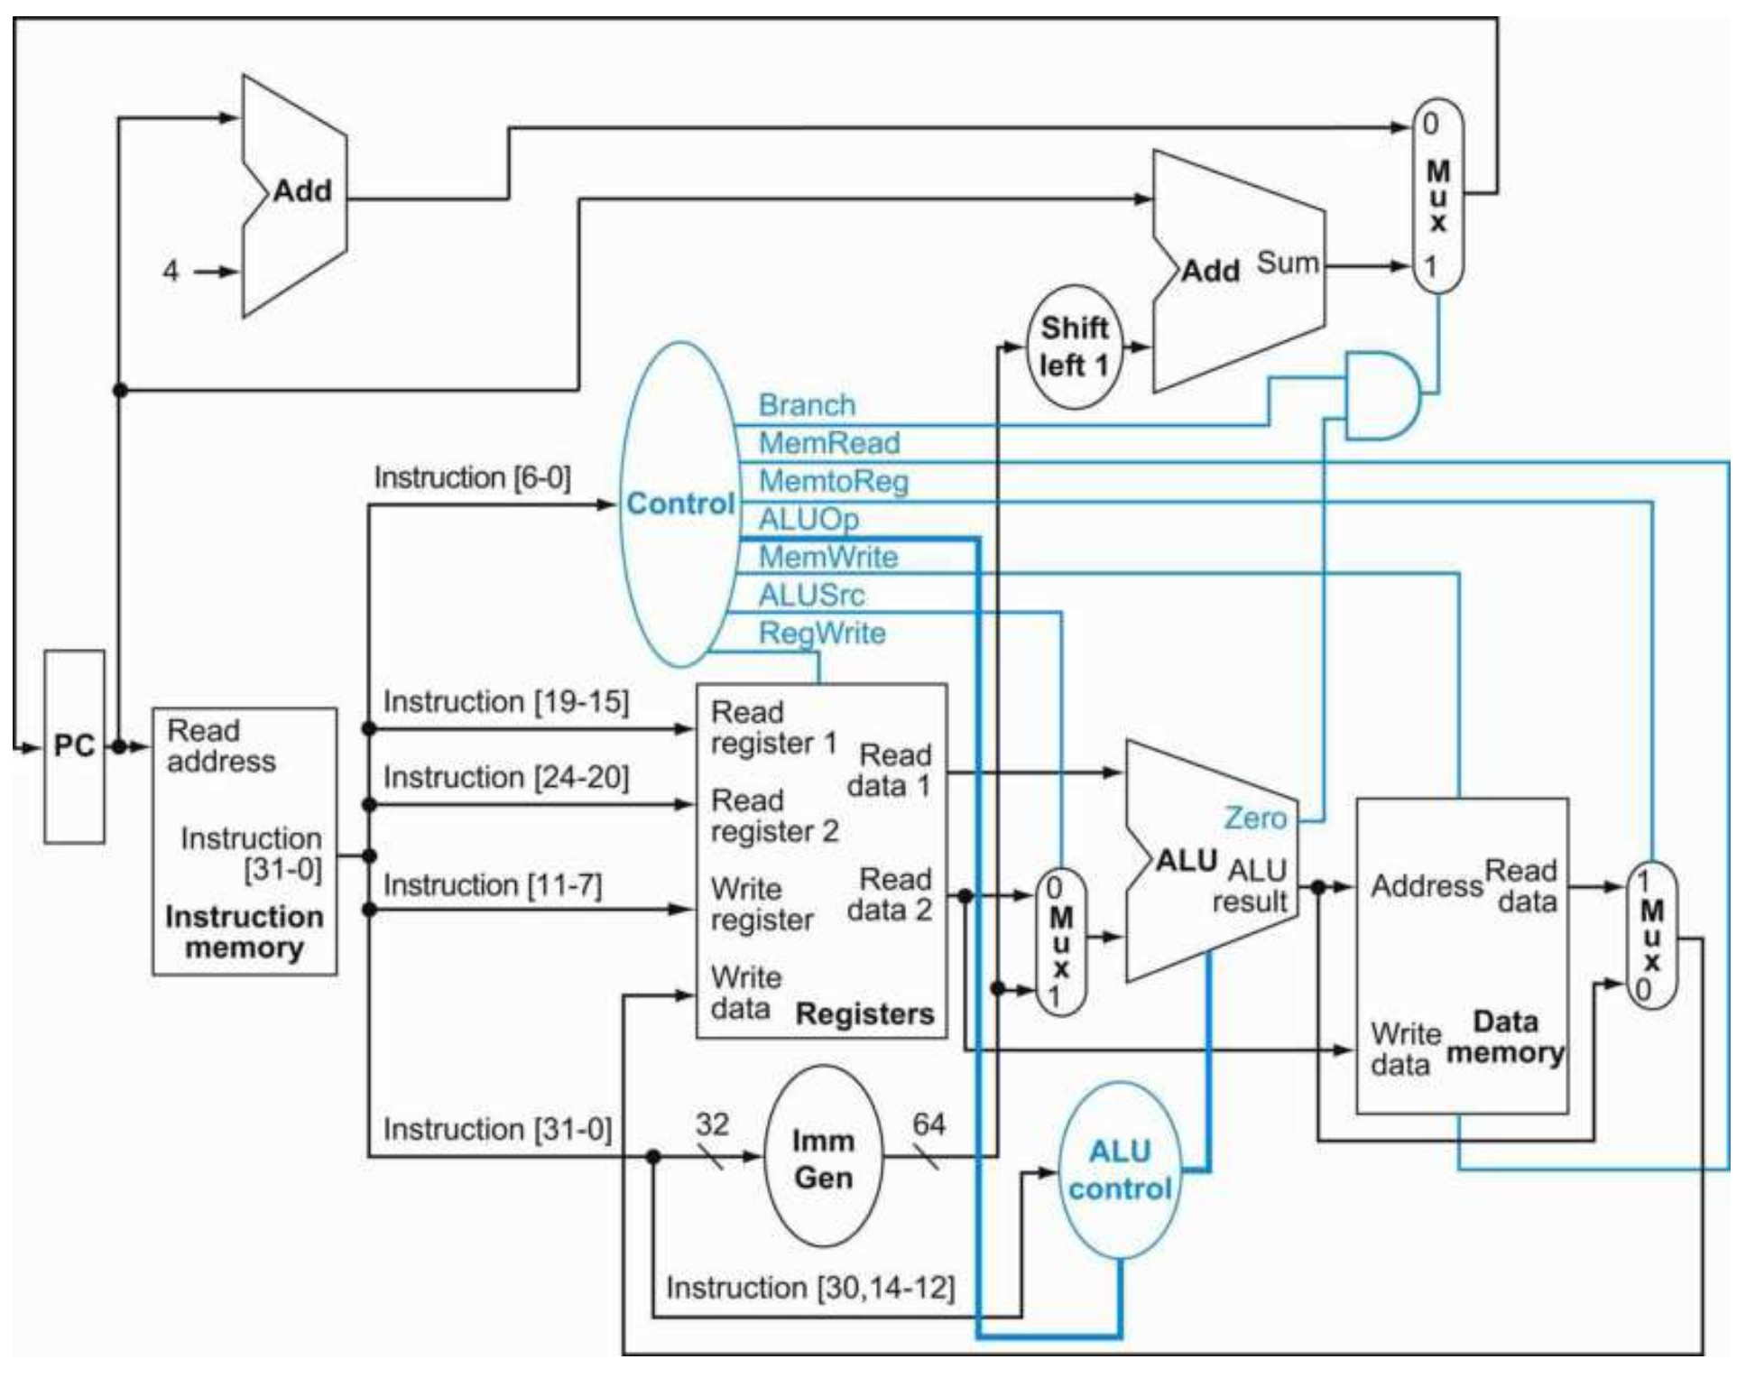
Basic RISC-V CPU Control Path
CPU control logic:
Main control
Register File
RegWrite
MemtoReg
ALU
ALUOp
ALUSrc
Data memory
MemRead
MemWrite
Branch
ALU control
ALU operation

Slide 13
Basic RISC-V CPU Control Path
Instruction | Opcode | RegWrite | AluSrc | Branch | MemRead | MemWrite | MemtoReg
R-Type | 0110011

Slide 14
Basic RISC-V CPU Control Path
Instruction | Opcode | RegWrite | AluSrc | Branch | MemRead | MemWrite | MemtoReg
R-Type | 0110011 | 1 | 0 | 0 | 0 | 0 | 0

Slide 15
Basic RISC-V CPU Control Path
Instruction | Opcode | RegWrite | AluSrc | Branch | MemRead | MemWrite | MemtoReg
I-Type | 0010011

Slide 16
Basic RISC-V CPU Control Path
Instruction | Opcode | RegWrite | AluSrc | Branch | MemRead | MemWrite | MemtoReg
I-Type | 0010011 | 1 | 1 | 0 | 0 | 0 | 0

Slide 17
Basic RISC-V CPU Control Path
Instruction | Opcode | RegWrite | AluSrc | Branch | MemRead | MemWrite | MemtoReg
LW | 0000011

Slide 18
Basic RISC-V CPU Control Path
Instruction | Opcode | RegWrite | AluSrc | Branch | MemRead | MemWrite | MemtoReg
LW | 0000011 | 1 | 1 | 0 | 1 | 0 | 1

Slide 19
Basic RISC-V CPU Control Path
Instruction | Opcode | RegWrite | AluSrc | Branch | MemRead | MemWrite | MemtoReg
SW | 0100011

Slide 20
Basic RISC-V CPU Control Path
Instruction | Opcode | RegWrite | AluSrc | Branch | MemRead | MemWrite | MemtoReg
SW | 0100011 | 0 | 1 | 0 | 0 | 1 | 0

Slide 21
Basic RISC-V CPU Control Path
Instruction | Opcode | RegWrite | AluSrc | Branch | MemRead | MemWrite | MemtoReg
BEQ | 1100011 | 0 | 0 | 1 | 0 | 0 | 0

Slide 22
Basic RISC-V CPU Control Path
How to determine the type of instruction with minimal logic?
Instruction | Opcode | RegWrite | AluSrc | Branch | MemRead | MemWrite | MemtoReg
R-Type | 0110011 | 1 | 0 | 0 | 0 | 0 | 0
I-Type | 0010011 | 1 | 1 | 0 | 0 | 0 | 0
LW | 0000011 | 1 | 1 | 0 | 1 | 0 | 1
SW | 0100011 | 0 | 1 | 0 | 0 | 1 | 0
BEQ | 1100011 | 0 | 0 | 1 | 0 | 0 | 0

Slide 23
Basic RISC-V CPU Control Path
R-Type := intrs[4] & instrs[5]
I-Type := intr[4] & ~instr[5]
LW := ~instr[4] & ~instr[5]
SW := ?
BEQ := ?
Instruction | Opcode | RegWrite | AluSrc | Branch | MemRead | MemWrite | MemtoReg
R-Type | 0110011 | 1 | 0 | 0 | 0 | 0 | 0
I-Type | 0010011 | 1 | 1 | 0 | 0 | 0 | 0
LW | 0000011 | 1 | 1 | 0 | 1 | 0 | 1
SW | 0100011 | 0 | 1 | 0 | 0 | 1 | 0
BEQ | 1100011 | 0 | 0 | 1 | 0 | 0 | 0

Slide 24
Basic RISC-V CPU Control Path
Instruction | Opcode | Func3 | Func7 | ALU Fn | ALU Op
AND | 0110011 | 000 | 0000000 | ADD | 10
SUB | 0110011 | 000 | 0100000 | SUB | 11
OR | 0110011 | 110 | 0000000 | OR | 01
AND | 0110011 | 111 | 0000000 | AND | 00
ADDI | 0010011 | 000 | xxxxxxx | ADD | 10
ORI | 0010011 | 110 | xxxxxxx | OR | 01
ANDI | 0010011 | 111 | xxxxxxx | AND | 00
LW | 0000011 | 010 | xxxxxxx | ADD | 10
SW | 0100011 | 010 | xxxxxxx | ADD | 10
BEQ | 1100011 | 000 | xxxxxxx | SUB | 11
ALUOp?
Only 4 operations:
AND
OR
ADD
SUB
BEQ := (rs1 – rs2)

Slide 25
Single-Cycle Processor
Single-cycle Processor:
Cycle I
Instruction memory read
Control Units produce output
ALU produces output
Data memory read
Next PC calculation
Note: Assume Instruction and data memory read is asynchronous (same cycle), however memory updates are only visible in next cycle.
Advantages?

Slide 26
Single-Cycle Processor
Single-cycle Processor Advantages:
Simple to design
Efficient design (resource usage)
Limitations?

Slide 27
Single-Cycle Processor
Single-cycle Processor Limitations:
Weak performance
Long latency

Slide 28
Single-Cycle Processor
Single-cycle Processor Latency:
Long propagation delay
Signal propagation from source to destination
Source: input or register
Destination: output or register
Imbalanced datapath
Which path is the longest?
Why it affects latency?

Slide 29
Single-Cycle Processor
Single-cycle Processor Latency:
How this affect CPU latency?
Longest delay determines the clock speed
CPU clock affects performance
CPU Time = InstCount * CPI * CycleTime
How to reduce propagation delay?

Slide 30
Single-Cycle Processor
Reducing Propagation Delay
Split the datapath into smaller chunks
Insert registers in between
Update control logic
Control registers inputs/outputs

Slide 31
Multi-Cycle Processor
Change to multi-cycle architecture
4 stages
IF: Instruction Fetch
ID: Register access
EX: ALU operation
MEM: Memory access
WB: Write back
IF
ID
EX
MM
WB

Slide 32
Multi-Cycle Processor
Improved Propagation Delay
Longest propagation delay?
max(IF, ID, EX, MEM, WB)
Should be smaller
How is the overall performance impacted?
IF
ID
EX
MM
WB

Slide 33
Multi-Cycle Processor
Multi-cycle Processor Performance
Pros: Cycle Time is reduced
Cons: CPI is increased: a single instruction takes multiple cycles to complete
CPU Time = InstCount * CPI * CycleTime
F
D
E
M
W
F
D
E
M
W
F
D
E
M
W
F
D
E
M
W

Slide 34
Pipelined Processor
Observations?
H/W resources are under utilized
When an instruction is stage WB
IF, ID, E, and MEM stages are idle (do nothing)
IF
ID
EX
MM
WB

Slide 35
Pipelined Processor
Solution
Fetch a new instruction each cycle
e.g: Executing instructions sequence: I0, I1, I2, I3, I4
I4
I3
I2
I1
I0
IF
ID
EX
MM
WB

Slide 36
Pipelined Processor
How it work?
The PC should be incremented each cycle
Online instructions are kept in pipeline registers
I4
I3
I2
I1
I0
IF
ID
EX
MM
WB

Slide 37
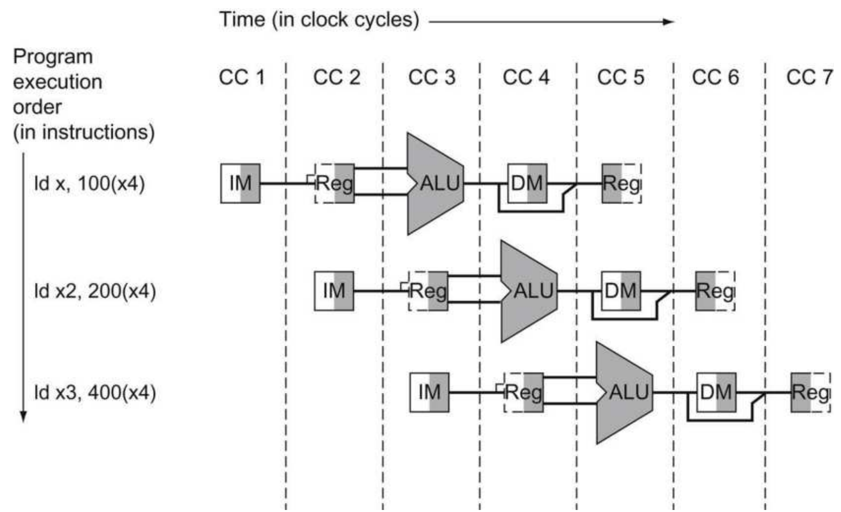
Pipelined Processor
Resource utilization

Slide 38
Pipelined Processor
Multi-cycle vs Pipelined performance
F
D
E
M
W
F
D
E
M
W
F
D
E
M
W
F
D
E
M
W
Time
F
D
E
M
W
F
D
E
M
W
F
D
E
M
W
F
D
E
M
W
F
D
E
M
W
Time

Slide 39
Pipelined Processor
Multi-cycle vs Pipelined performance
The CPI is reduced
Ideal pipelined CPI is 1
One instruction complete each cycle
CPU Time = InstCount * CPI * CycleTime

Slide 40
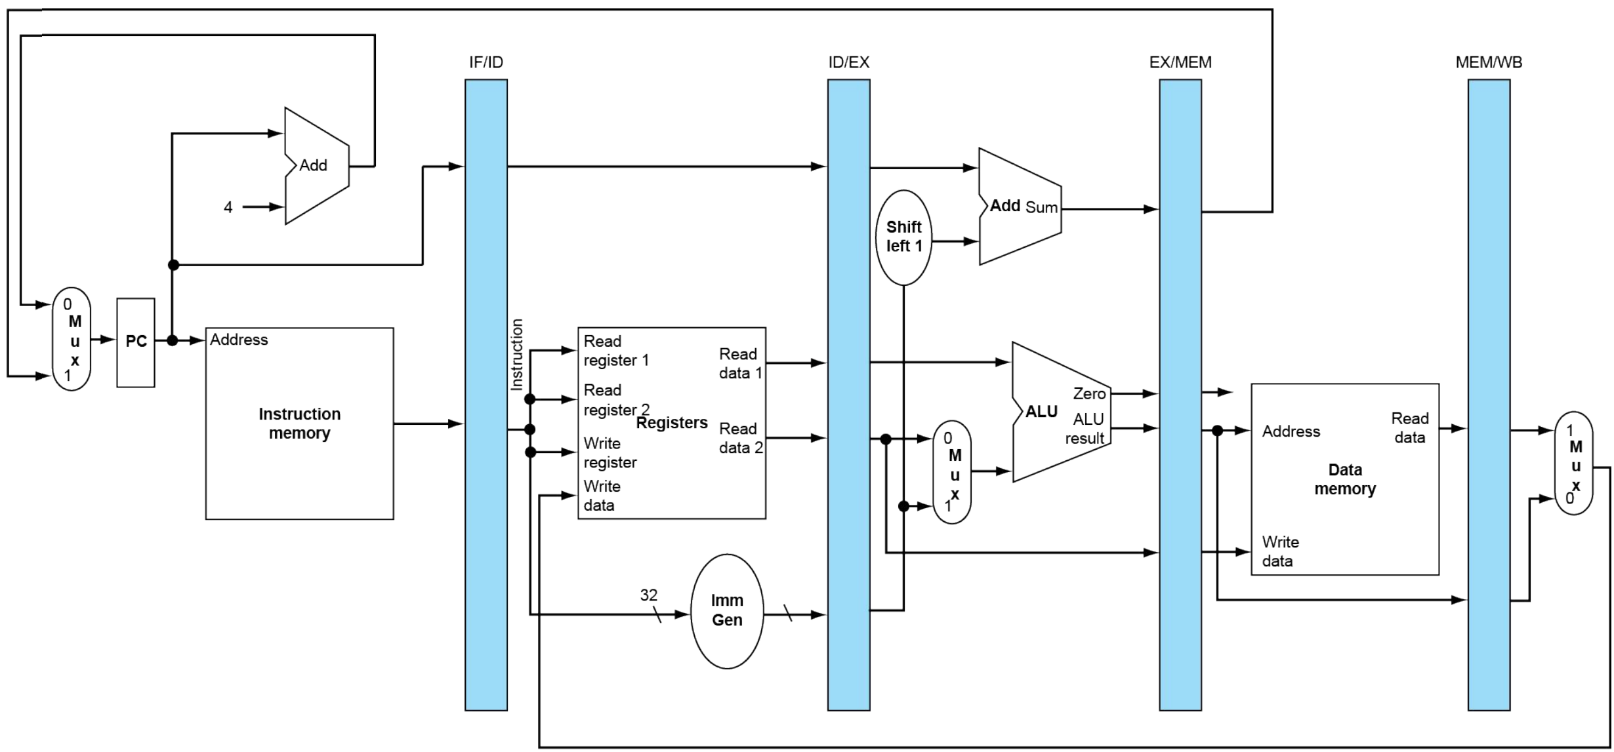
5-Stage Pipeline RISC-V Processor

Slide 41
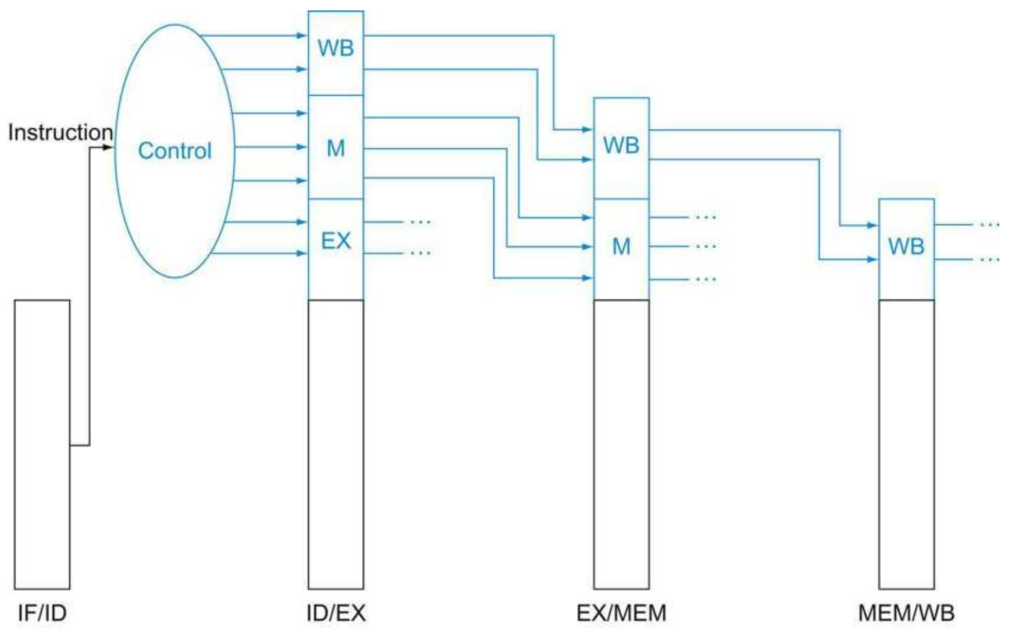
5-Stage Pipeline RISC-V Processor
Pipelined control logic
Propagate the flags along the pipeline

Slide 42
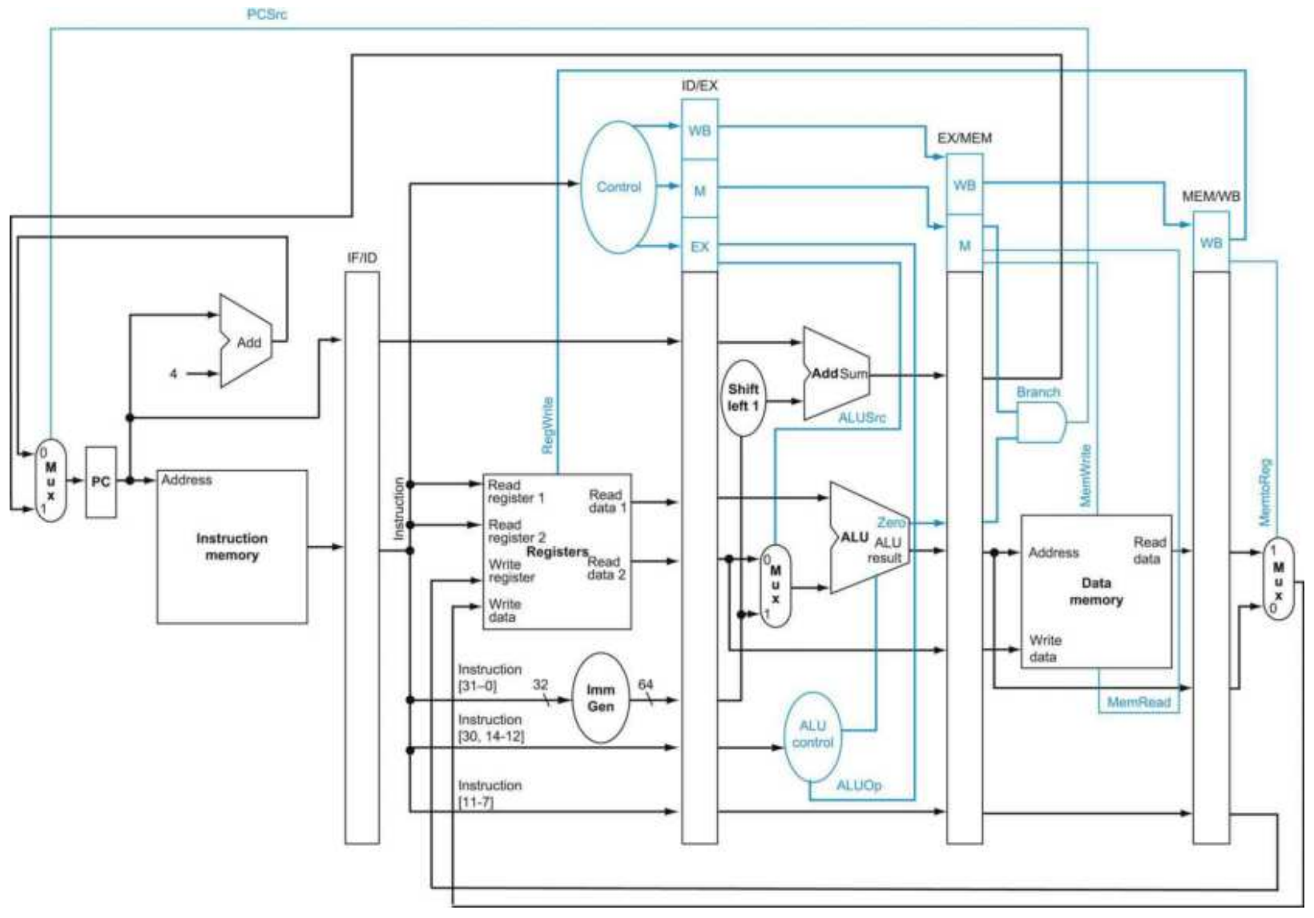
Basic RISC-V CPU Control Path
Data & Control Path

